Slide 1

DATA STRUCTURES AND ALGORITHMS.
This seminar helps us to understand the algorithmic approach to graphs and trees. We will discuss what a graph is, what a tree is, what is algorithm and the traversal methods.
Presented by Branson and Precious.

Slide 2
Graphs, Trees And Algorithm
What is a Graph?
A graph is an ADT consisting of Vertices (nodes) and a set of Edges (connections between nodes).
What is a Tree?
A tree is a special type of graph that is connected and Acyclic (i.e contains no cycles).
We will be discussing the Traversal Algorithm Method to further help us understand these ADTs. First, what is Algorithm?
Algorithms can be defined as a step-by-step procedure for solving a problem or accomplishing a task. The traversal algorithm includes:
Breadth First Search (BFS)
Depth First Search (DFS)

Slide 3

BREADTH FIRST SEARCH
Breadth first search (BFS) is a common algorithm used to navigate and explore graph or tree data structures. It is an algorithm used for traversing or searching tree or graph data structures. It starts at the root node (or any arbitrary node in a graph) and explores all the nodes at the current depth level before moving on to the nodes at the next depth level.
This algorithm maintains a queue to keep track of the nodes to visit. It starts by enqueuing the root node, the dequeuing the front node from the queue, visiting it and enqueuing all its adjacent nodes (i.e nodes directly connected to it that have not been visited yet). It repeats this process until the queue is empty.

Slide 4
APPLICATIONS OF BREADTH FIRST SEARCH
Shortest Path Findings: BFS can be used to find the shortest path between two nodes in a graph or a tree. It guarantees that the shortest path to a node will be found if it exists.
Web Crawlers: It is used to discover web pages and build a map of the websites. Starting from the root page, BFS traverses all the linked pages at the same depth level before moving on to the next level, ensuring that the entire website is visited.
Network Routing: It is used to find the shortest path between two nodes in a network. This helps to efficiently route data packets through the network.
Social Network Analysis: BFS can be used to analyze social networks by identifying the friends of a user, the friends of friends, and so on. It can also be used to find the shortest path between two users in a social network.
Puzzle solving: It can be used to solve puzzles such as the 8-puzzle or the Rubik’s cube by exploring all possible states of the puzzle and finding the shortest path to the solution.
Image processing: It can be used in image processing to find connected components of an image, which are regions of pixels that are connected to each other.
Overall, BFS is a versatile algorithm that has a wide range of applications in computer science and other fields.

Slide 5

PSEUDOCODE FOR BREADTH FIRST SEARCH
The Breadth first search (BFS) algorithm starts at the root node (or any arbitrary node in a graph) and explores all the nodes at the current depth level before moving on to the nodes at the next depth level.
Step 1: Initialize a queue and enqueue the starting node into it.
Step 2: Mark the starting node as visited.
Step 3: While the queue is not empty, do the following:
Dequeue the node at the front of the queue
Visit the dequeued node
Enqueue all the adjacent nodes (i.e, nodes directly connected to it that have not been visited yet) into the queue and mark them as visited.
Step 4: Repeat step 3 until the queue is empty
Note that BFS guarantees that the shortest path to a node will be found if it exists. The algorithm uses a First-In-First-Out (FIFO) queue to maintain the order in which nodes are visited. Nodes are visited in the order in which they are dequeued from the queue, ensuring that all nodes at a certain depth level are visited before moving on to the nodes at the next depth level.
BFS(G, start_node): queue = [start_node] visited = set(start_node) while queue is not empty: current_node = queue.dequeue() for neighbor in G.adjacent_nodes(current_node): if neighbor not in visited: visited.add(neighbor) queue.enqueue(neighbor)
G is the graph to be searched
start_node is the node to start the search from
queue is a FIFO data structure used to keep track of nodes to visit
visited is a set used to keep track of visited nodes
adjacent_nodes(node) is a function that returns the neighbors of the given node in the graph G

Slide 6
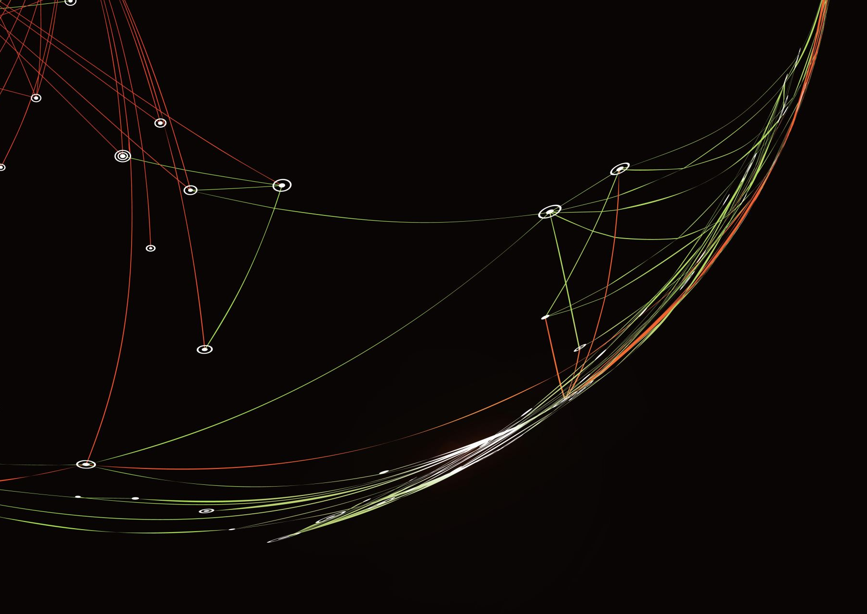
DEPTH FIRST SEARCH
Depth First Search (DFS) is a graph traversal algorithm that explores a graph or tree by visiting as far as possible along each branch before backtracking. It starts at a chosen node, explores all its unvisited neighbors, and repeats the process recursively. It is like navigating a maze, going down one path until you hit a dead-end, then retracing your steps and exploring another path.
We have two (2) methods that are typically used to implement DFS efficiently, these methods include:
RECURSIVE APPROACH
ITERATIVE APPROACH

Slide 7

Recursive Approach And Iterative Approach
Recursive Approach
In the recursive approach, the algorithm starts at the source vertex and marks it as visited. It recursively explores every unvisited neighbor of the source vertex. When no more unvisited neighbors are left, the algorithm backtracks to the previous vertex in the stack and repeats the process until all vertices in the graph are visited.
Iterative Approach
In the iterative approach, the algorithm uses a stack to keep track of the vertices that need to be visited next. It starts at the source vertex, marks it as visited, and pushes it onto the stack. Then, it repeatedly pops the top vertex from the stack, explores its unvisited neighbors, and makes them onto the stack until all are visited.

Slide 8

APPLICATIONS OF DFS ALGORITHM
DFS (Depth-First Search) is a robust algorithm with various applications across various domains. DFS, or Depth-First Search, is a versatile algorithm that finds applications across multiple domains. Some of the standard applications of DFS are:
1. Path Finding - PathFinding using DFS involves exploring all possible paths in a graph to identify the shortest or longest path between two nodes. This technique is helpful in navigation systems, where we need to find the most efficient route between the two locations.
2. Topological Sorting - DFS performs topological sorting of a directed acyclic graph (DAG). DFS helps to order the nodes in a graph so that no node comes before that node. This technique is used in project dependency graphs or scheduling problems.
3. Cycle Detection - DFS is used to detect cycles in a graph. By exploring all the edges in the graph, DFS can identify if a cycle is present. If we encounter a visited child who is not the immediate parent of the current node during traversal, cycle detection occurs. It can be helpful in various applications, such as detecting deadlock in a computer system.
4. Lowest Common Ancestor(LCA) - DFS comes in handy to find the LCA of two vertices in a tree. We start at the tree's root and perform a DFS until we reach one of the two nodes. We backtrack and mark the visited nodes on the path to the first node. We then continue the DFS until we reach the second node. At this point, we can backtrack again and find the lowest marked node, the LCA.
5. Finding Strongly Connected Components - DFS can find strongly connected components in a directed graph. Strongly connected components are a set of nodes that are all reachable from each other by applying DFS on the transposed graph. It is helpful in applications such as detecting communities in social networks or image processing.
6. Maze Generation - DFS is used to generate mazes. By randomly selecting a starting point and exploring all possible paths in a grid, DFS can create a unique maze that can be solved using graph algorithms.
7. Finding Bridges and Articulation Points - DFS finds bridges and articulation points in a graph. Bridges are edges that, when removed, increase the number of connected components in the graph. Articulation points are nodes that, when removed, disconnect the graph. It can be helpful in network analysis and designing resilient computer systems.
Overall, DFS is a fundamental graph traversal algorithm that explores as far down a branch as possible before backtracking. It uses stack (explicit or implicit via recursion) to manage exploration.

Slide 9

PSEUDOCODE FOR DEPTH FIRST SEARCH ALGORITHM
This algorithm explores as far as possible along each branch before backtracking. The stack keeps track of the visited nodes and ensures that vertices are processed in a depth-first order. It is important to note that the DFS algorithm may only sometimes visit all nodes in a graph, particularly if disconnected. The algorithm must be applied separately to each connected graph component to ensure all nodes are visited.
DFS(graph, start_node):
// Mark the starting node as visited
visited = {}
visited[start_node] = true
// Visit the starting node
visit(start_node)
// Get all adjacent nodes of the starting node
adjacent_nodes = graph.get_adjacent_nodes(start_node)
// Loop through all the adjacent nodes
for next_node in adjacent_nodes:
// If the adjacent node is not visited, mark it as visited and perform DFS on it
if next_node not in visited:
visited[next_node] = true
DFS(graph, next_node)

Slide 10
PSEUDOCODE FOR THE CODE TO BE PRESENTED
BFS
DFS
FUNCTION BFS(graph, start, visited):
Initialize an empty queue
Enqueue the start node
Initialize an empty component list
WHILE queue is not empty:
Dequeue a node as current
IF current not in visited:
Add current to visited
Add current to component
FOR each neighbor of current in graph:
IF neighbor not in visited:
Enqueue neighbor
RETURN component
FUNCTION Discover_Regions_BFS(graph):
Initialize visited as empty set
Initialize regions list as empty
FOR each node in graph:
IF node not in visited:
region = BFS(graph, node, visited)
Append region to regions list
RETURN regions
FUNCTION DFS(graph, node, visited, component):
Add node to visited
Append node to component
FOR each neighbor of node in graph:
IF neighbor not in visited:
Call DFS(graph, neighbor, visited, component)
FUNCTION Discover_Regions_DFS(graph):
Initialize visited as empty set
Initialize regions list as empty
FOR each node in graph:
IF node not in visited:
Initialize empty component list
Call DFS(graph, node, visited, component)
Append component to regions list
RETURN regions
These two algorithms help identify connected clusters of islands (regions) where each island is a node and each bridge is an edge. Both approaches will yield the same result – the list of separate island regions – but they explore the graph differently.

Slide 11
THANK YOU

